Slide 1
Computer Aided Design
First Robotics 4669
Galileo High School
Ken Fujimoto

Slide 2
Creating A Model
Model is an assembly which consists of parts
Two main types of files in Autodesk Inventor
.ipt - Inventor ParT file
.iam- Inventor AsseMbly file
Part files may be created by users or download from manufacturers
Assembly files created by selecting and connecting parts
Assemblies may also consist of connected sub assemblies

Slide 3
Parametric Models
Parameters are values which can be used to describe a model
Length, width and height are common parameters
The power of parameters is that the values can be changed after the model is built and the model will automatically update
With the proper model things like the robot’s width, height and length can be adjusted
Other things like arm length, location and width can also be adjusted

Slide 4
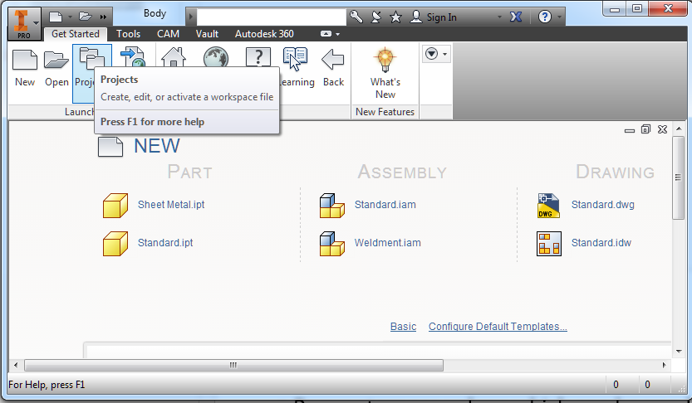
Setting Up The Project
Start Autodesk Inventor
Click on the Projects button
Click on the New button
Select New Single User Project
Click Next
Enter Project Name and Folder
Click Finish then Ok

Slide 5
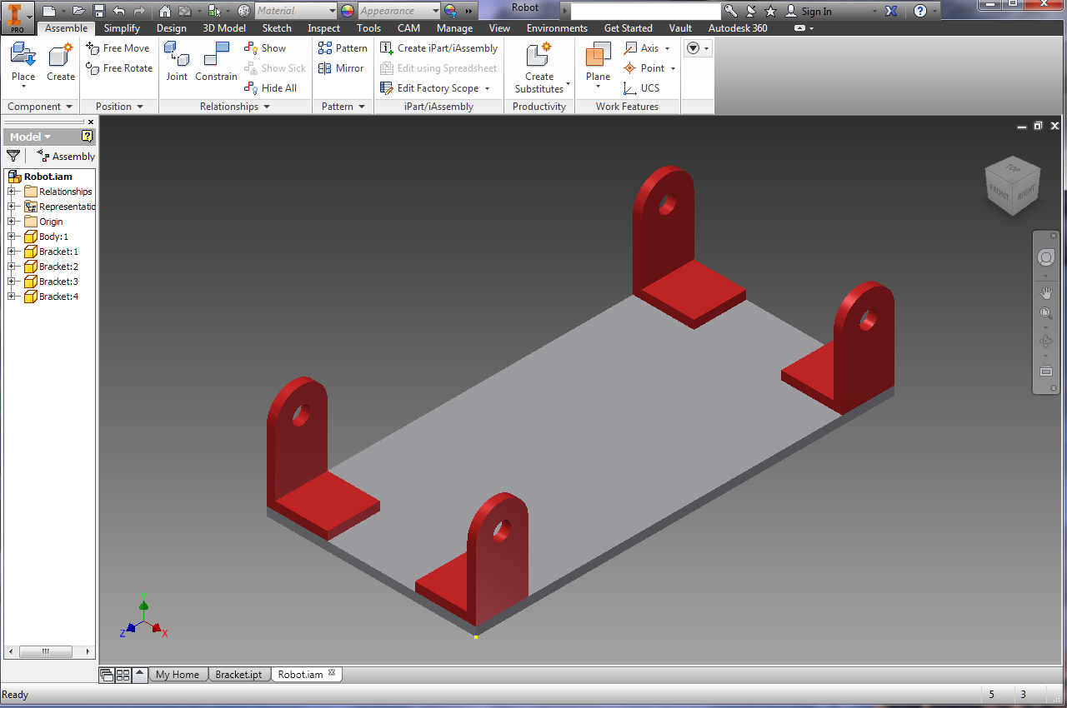
Model To Be Created

Slide 6
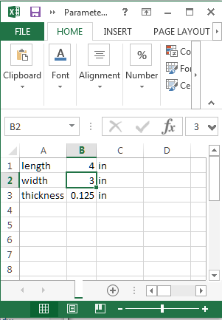
Setting Up The Parameter Worksheet
Start Microsoft Excel
Select New Blank Workbook
Enter the length, width and thickness as shown
Save the worksheet with the name “Parameters” in the Inventor Project directory you just created

Slide 7
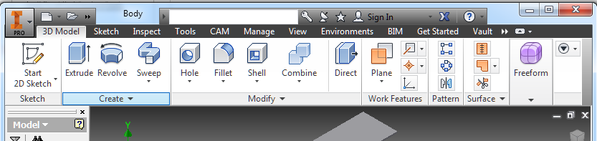
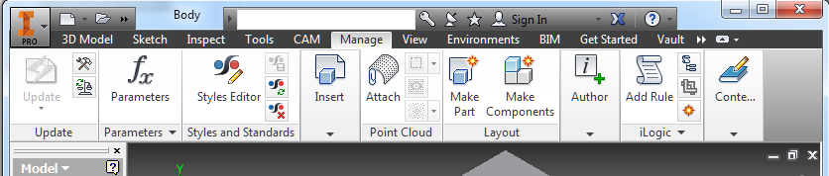
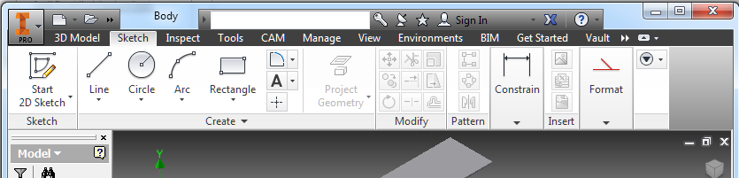
Tool Bar Tabs
The tool buttons are organized into tabs which are named 3D Model, Sketch, Inspect, Tools, CAM, Manage, View etc.

Slide 8
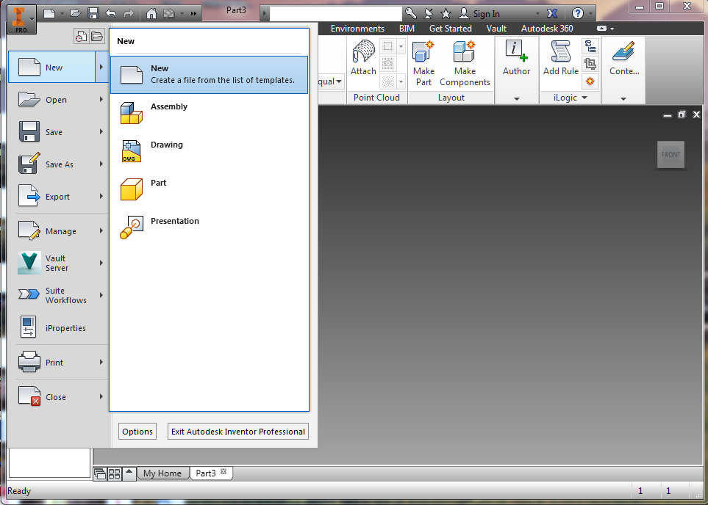
Creating A Part
In the I menu (top left) cIick New and select New
In the left window of the dialog click on English
In the middle double click on Standard (in).ipt
Click on the I in the top left to Save the part as “Body”

Slide 9
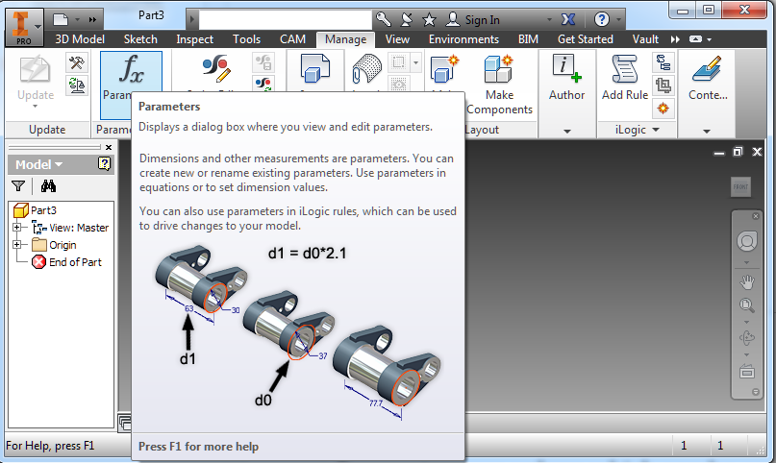
Connecting Parameters to the Part
Click on the Manage Tab
Click on the Parameters Button
Click on the Link Button in the lower left
Select the Parameters Workbook in the Project Directory
Click Done

Slide 10
Creating Volumes
Parts are made by adding and subtracting 3D volumes
Volumes are made by first creating a 2D sketch and then extruding it into 3D
The 2D sketches must first be placed and oriented in 3D space
Next 2D lines and shapes are added to the sketch
Finally the 2D shapes are extruded into 3D volumes

Slide 11
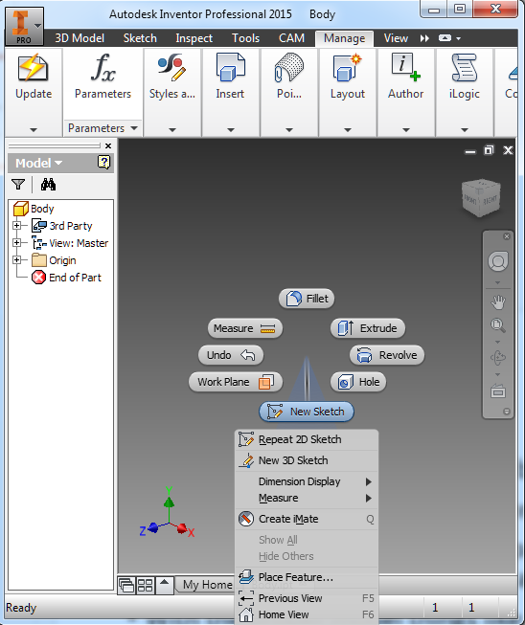
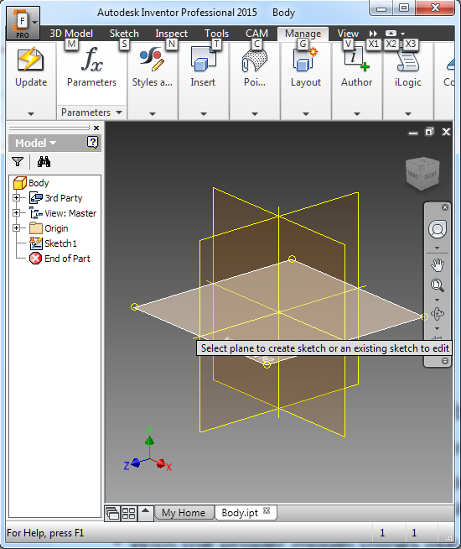
Creating A Sketch
Right click in the lower right part view and select New Sketch
Click the plane for the sketch.
Choose the XZ plane

Slide 12
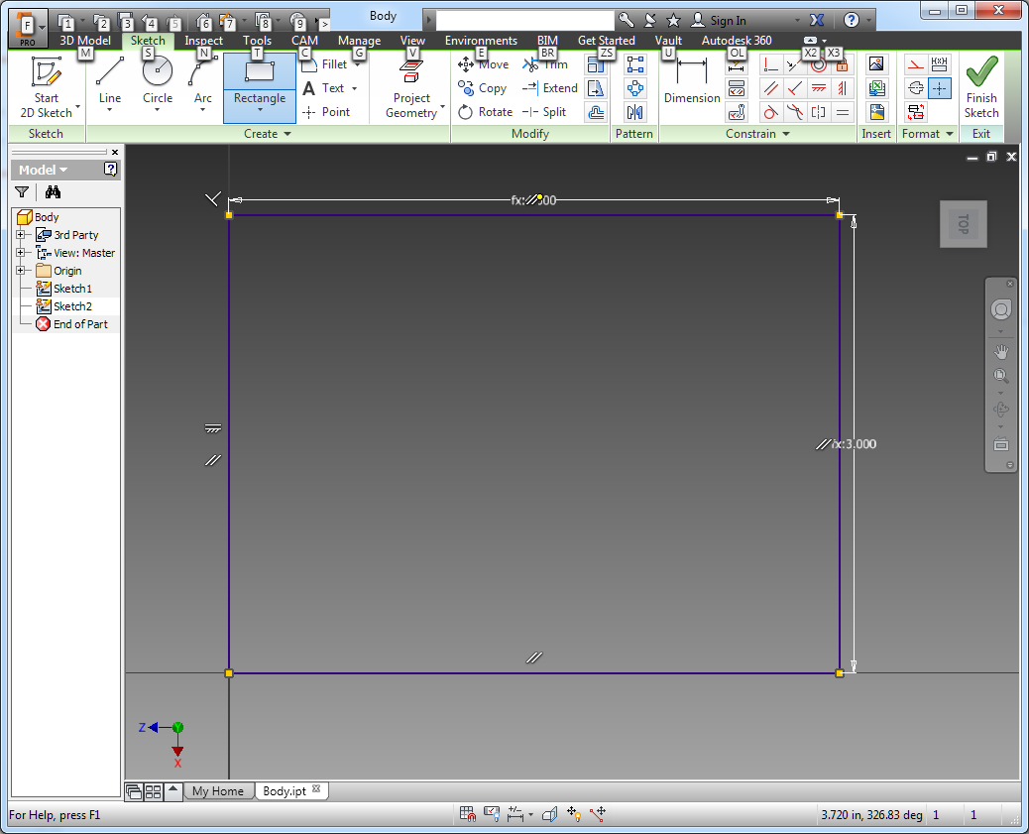
Draw Rectangle
Click the Rectangle Button
Click on the yellow origin dot
Drag mouse up and right
Type ‘width’
Press the Tab key
Type ‘length’
Press Enter key

Slide 13
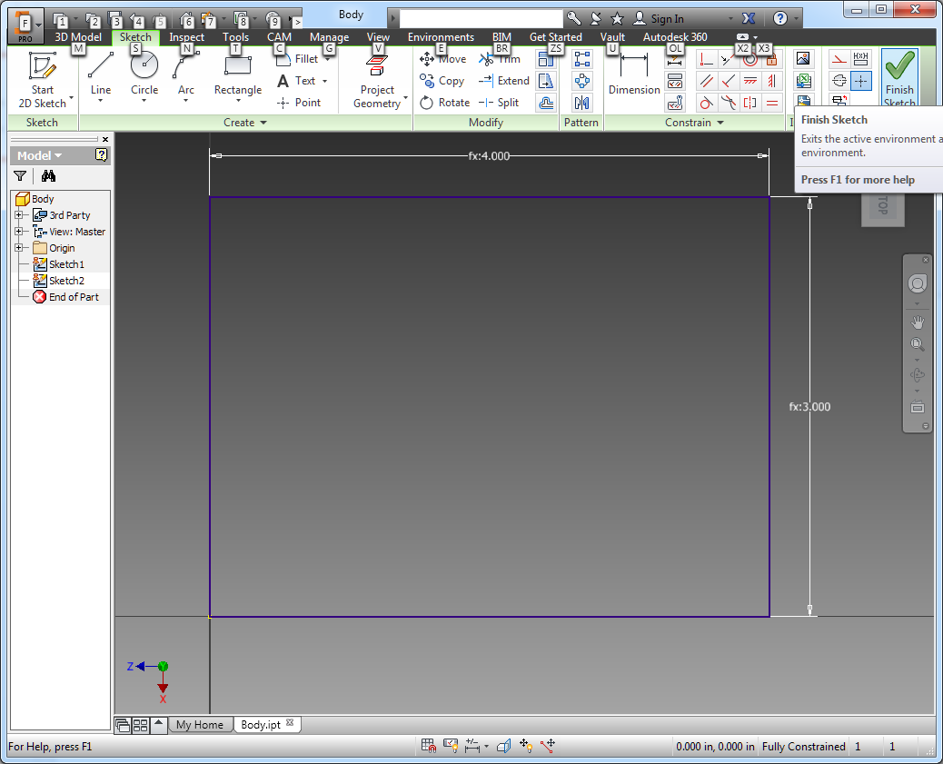
Finish Sketch
Click Finish Sketch Button

Slide 14
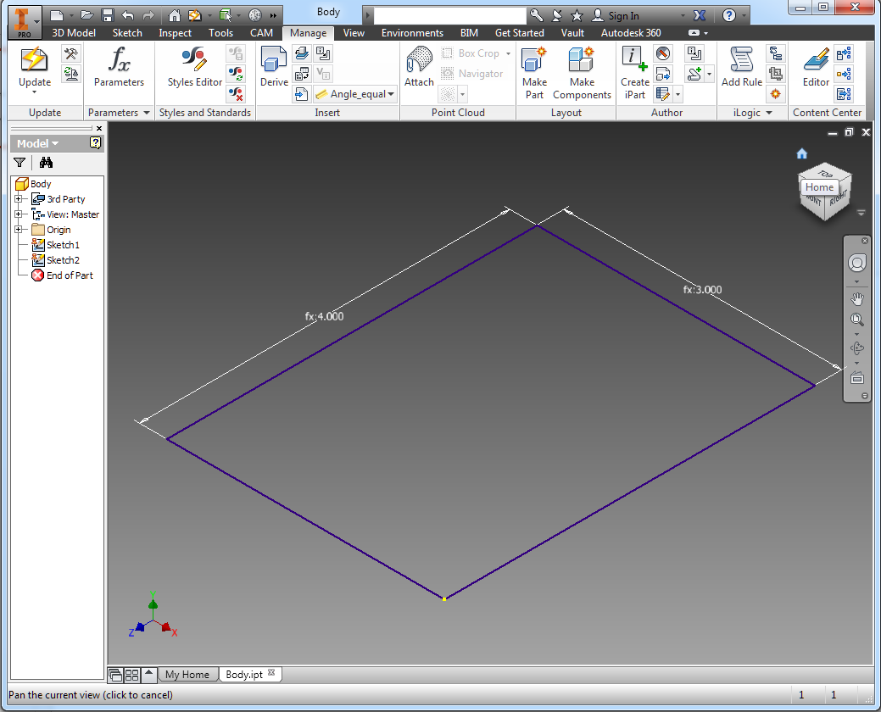
Center Drawing
Click the little house icon above the cube in the upper right part of the part window to center the drawing

Slide 15
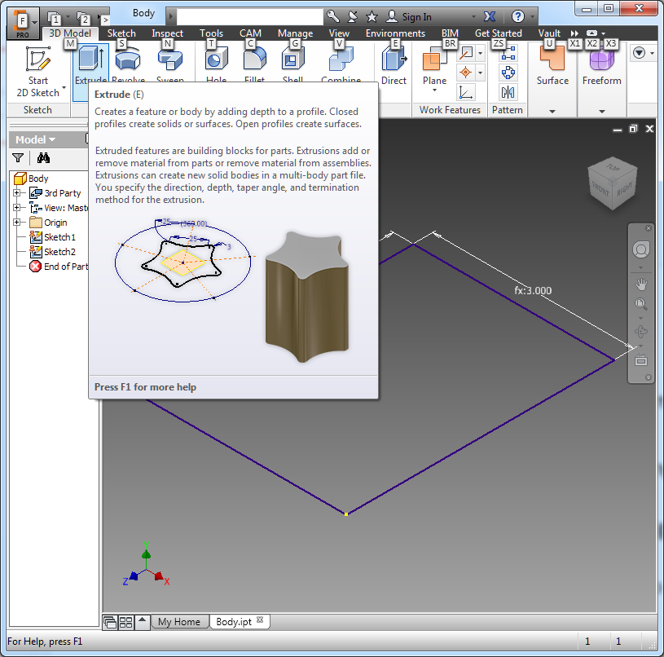
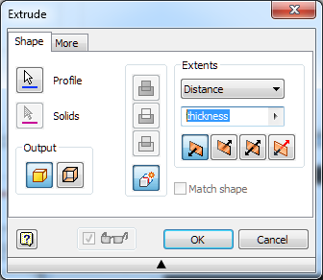
Extrude
Click on the Extrude button under the 3D Model tab
In the Extrude dialog type in ‘thickness’ under the Distance dropdown
Click OK in the dialog

Slide 16
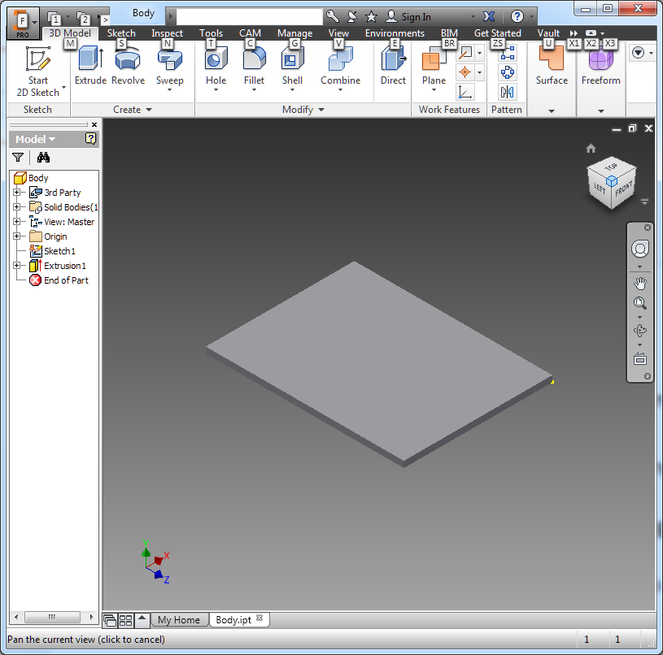
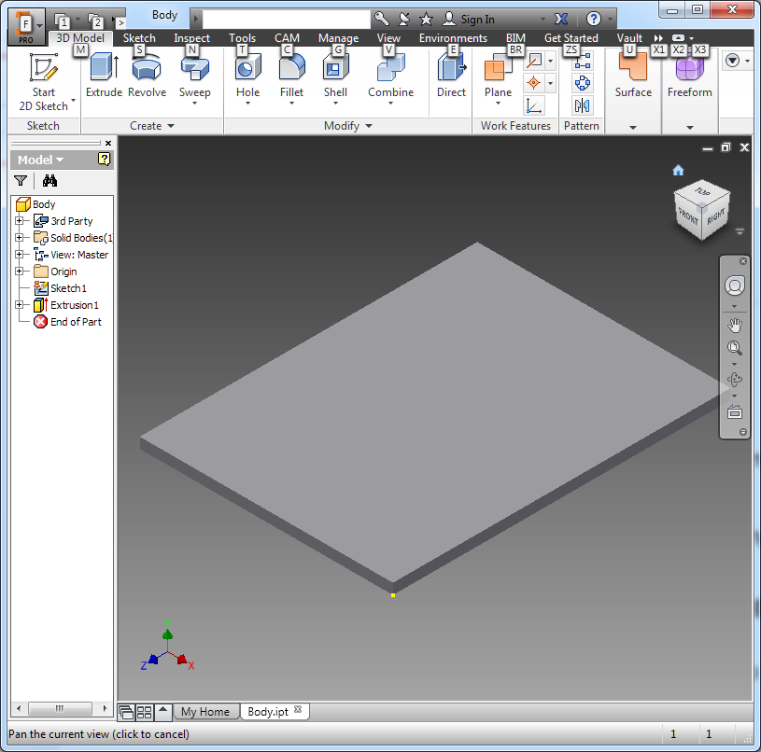
Navigation Cube
To view the part from various directions, you can click on the faces, corners or edges of the cube to rotate and scale the part
Clicking on the house icon returns you to the home view

Slide 17
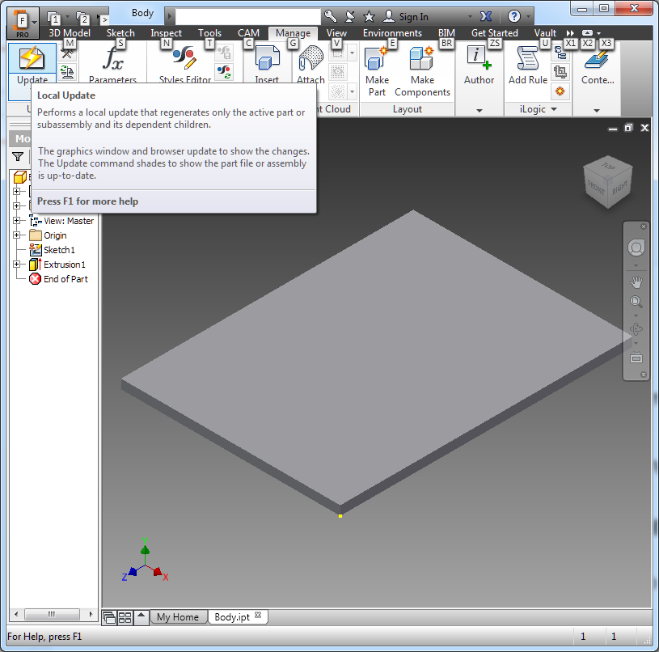
Changing Parameters
Change the length in the spreadsheet to 7 in
Save the spreadsheet
Go to Manage tab and click on the Update button to see the model change

Slide 18
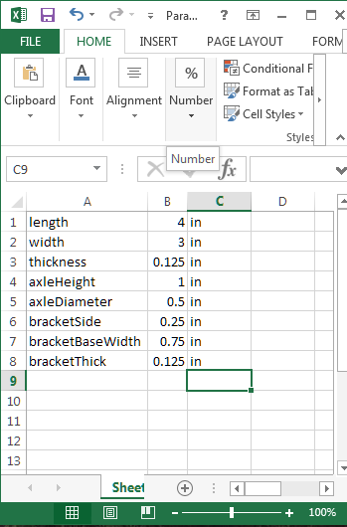
Create Bracket Parameters
To create a bracket to connect an axle to the body, the parameters need to be defined
Add the bracket parameters axleHeight, axleDiameter, bracketSide, bracketBaseWidth, and bracketThick to the spreadsheet
Save the spreadsheet
You should never type numbers into parts files. All dimensions should come from the Parameter spreadsheet or be defined as equations of parameters

Slide 19
Creating The Bracket Part
In the I menu (top left) cIick New and select New
In the left window of the dialog click on English
In the middle double click on Standard (in).ipt
Click on the I in the top left to Save the part as “Bracket”

Slide 20
Connecting Parameters to the Bracket Part
Click on the Manage Tab
Click on the Parameters Button
Click on the Link Button in the lower left
Select the Parameters Workbook in the Project Directory
Click Done

Slide 21
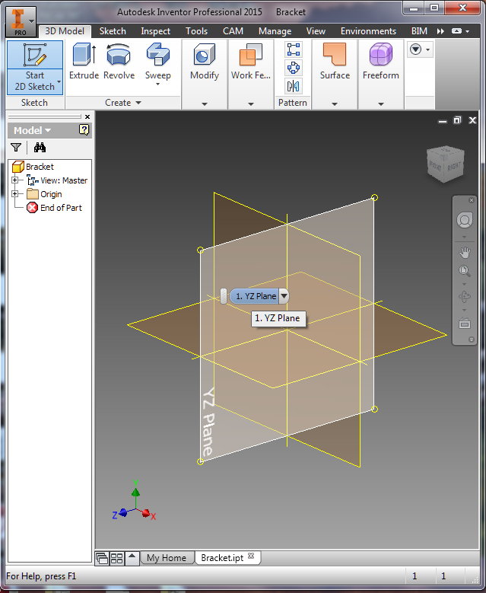
Creating The Bracket Sketch
Right click in the lower right part view and select New Sketch
Click the plane for the sketch.
Choose the YZ plane

Slide 22
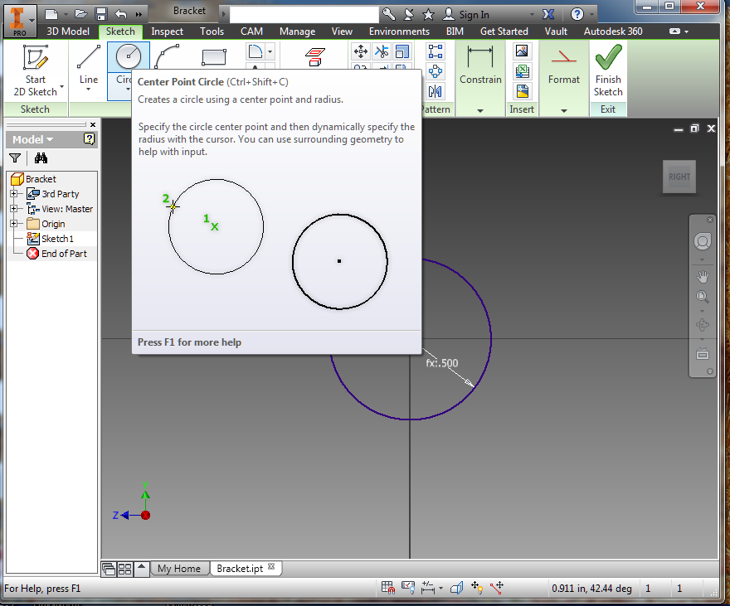
Draw Circle
Click the Circle Button
Click on the yellow origin dot
Drag mouse right
Type ‘axleDiameter+2*axleSide’
Press Enter key
Click Finish Sketch

Slide 23
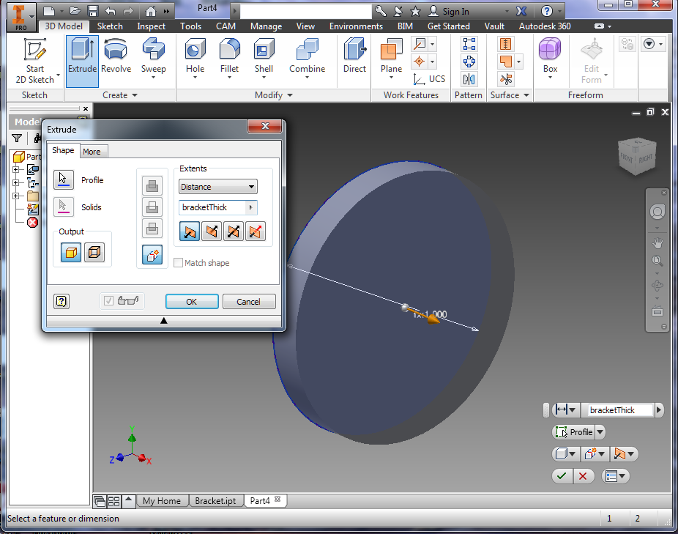
Extrude
Click on the Extrude button under the 3D Model tab
In the Extrude dialog type in ‘bracketThick’ under the Distance dropdown
Click OK in the dialog

Slide 24
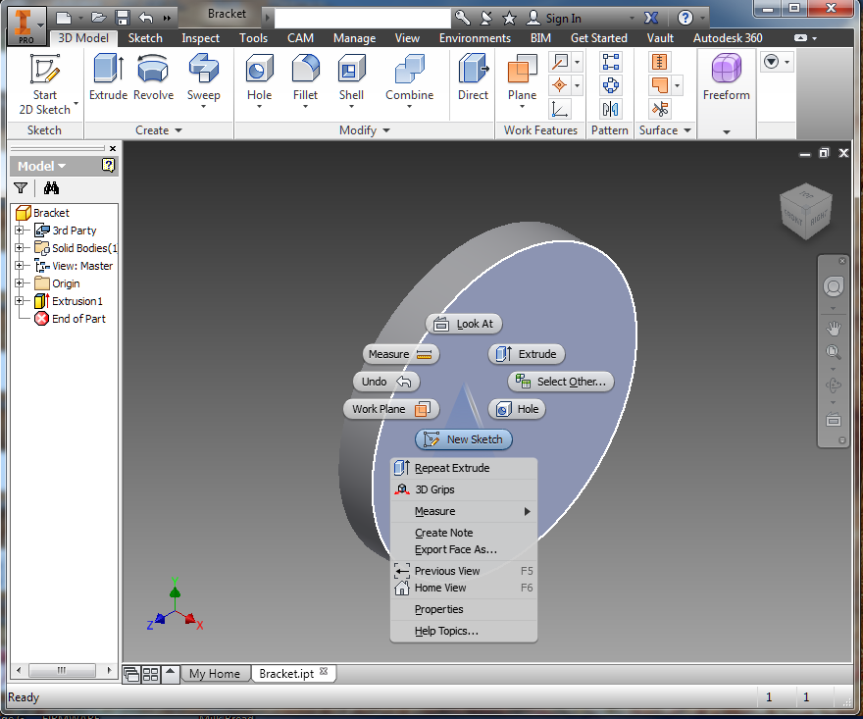
Create Sketch
Right Click on the flat face of the disc and select New Sketch

Slide 25
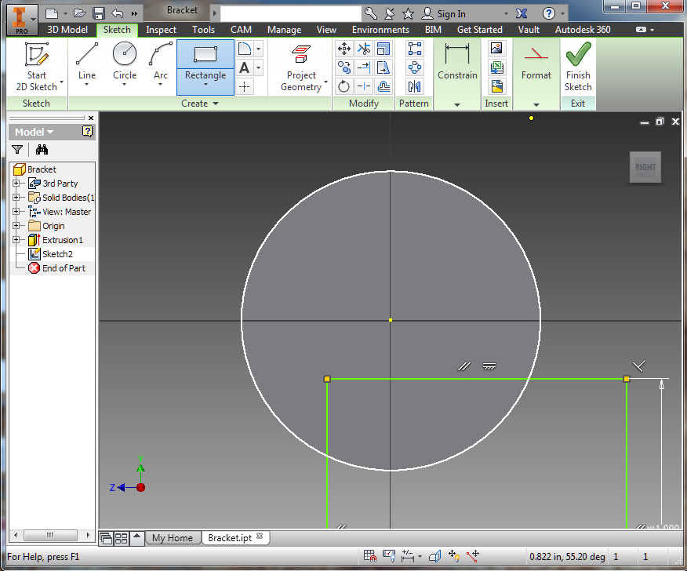
Draw Rectangle
Select the Rectangle Tool and click on the sketch below and to the left of the center of the disc
Drag mouse down and right
Type ‘axleDiameter+2*axleSide’
Press the Tab key
Type ‘axleHeight’
Press Enter key

Slide 26
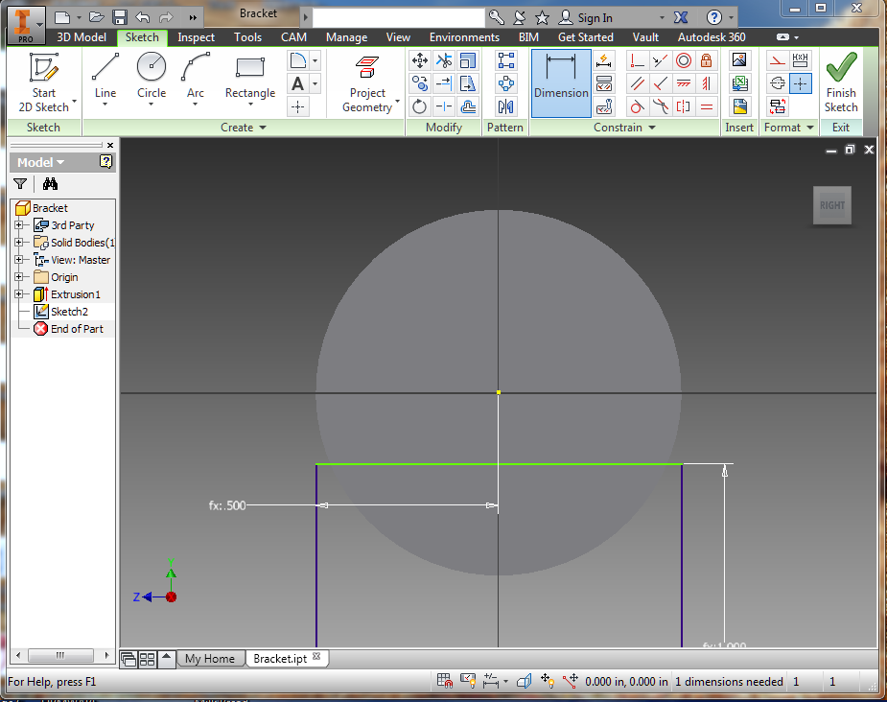
Constrain Horizontal Location
Select Dimension Tool
Click on left side of rectangle
Click on yellow origin
Drag mouse down and click
Type ‘axleDiameter/2+bracketSide’ into dialog
Press Enter

Slide 27
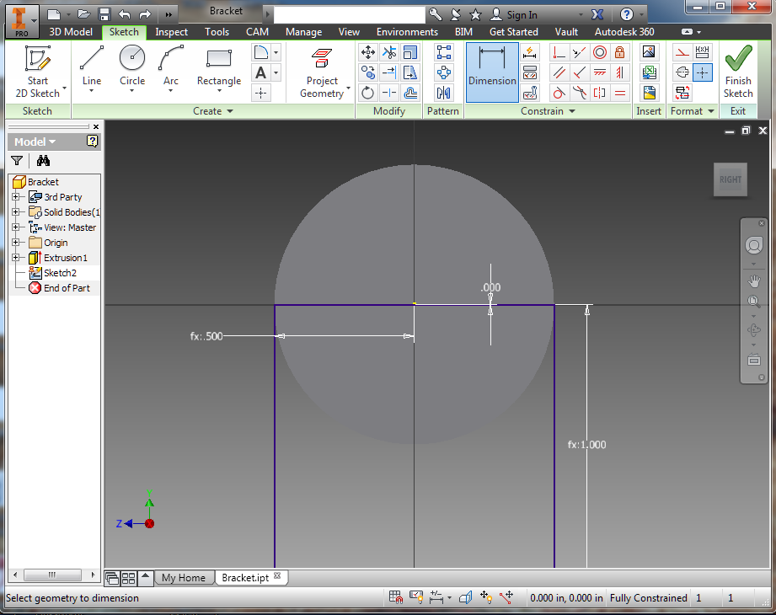
Constrain Vertical Location
Select Dimension Tool
Click on top of rectangle
Click on yellow origin
Drag mouse right and click
Type 0 into dialog
Press Enter
Click Finish Sketch

Slide 28
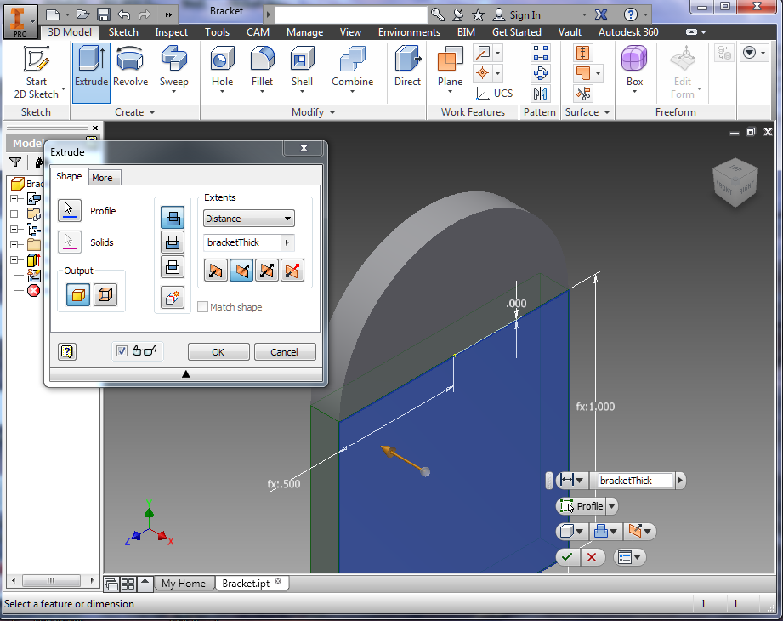
Extrude
Click on the Extrude button
In the Extrude dialog type in ‘bracketThick’ under the Distance dropdown
Select the second button for the extrusion direction and the top button for the join
Match the selections in the picture
Click OK in the dialog

Slide 29
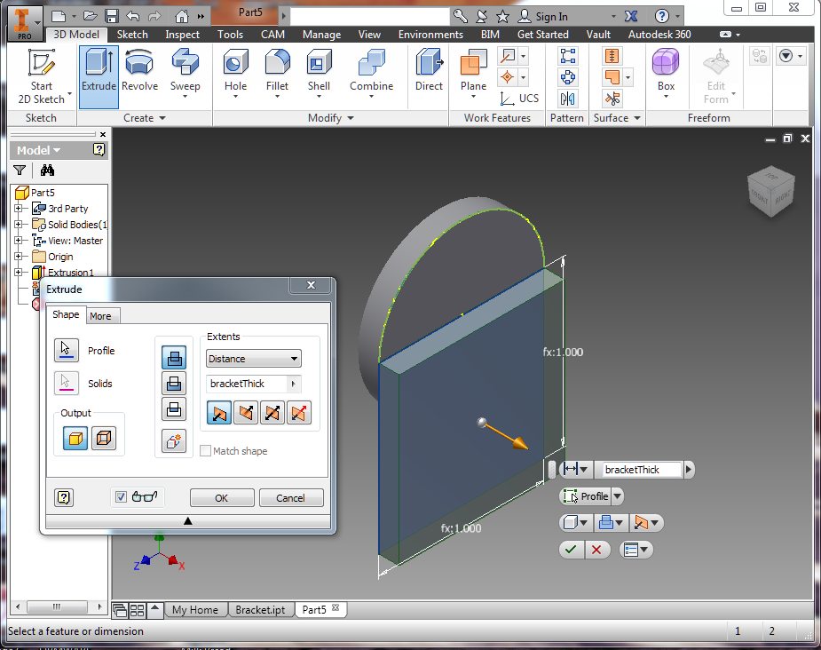
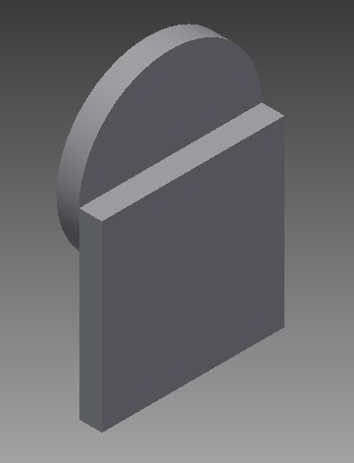
Join Outward Extrusion
Selecting different Extrusion options results in different shapes
Select Join and the Outward Direction results in a this shape

Slide 30
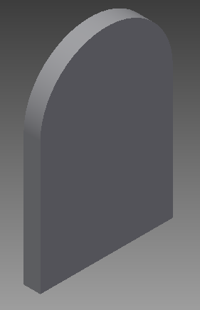
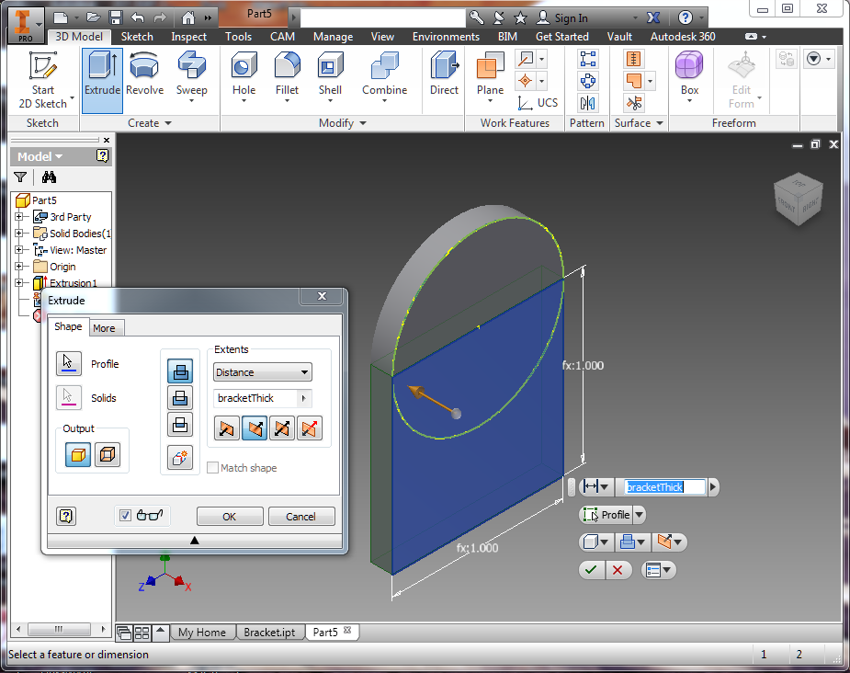
Join Inward Extrusion
Select Join and the Inward Direction results in a this shape

Slide 31
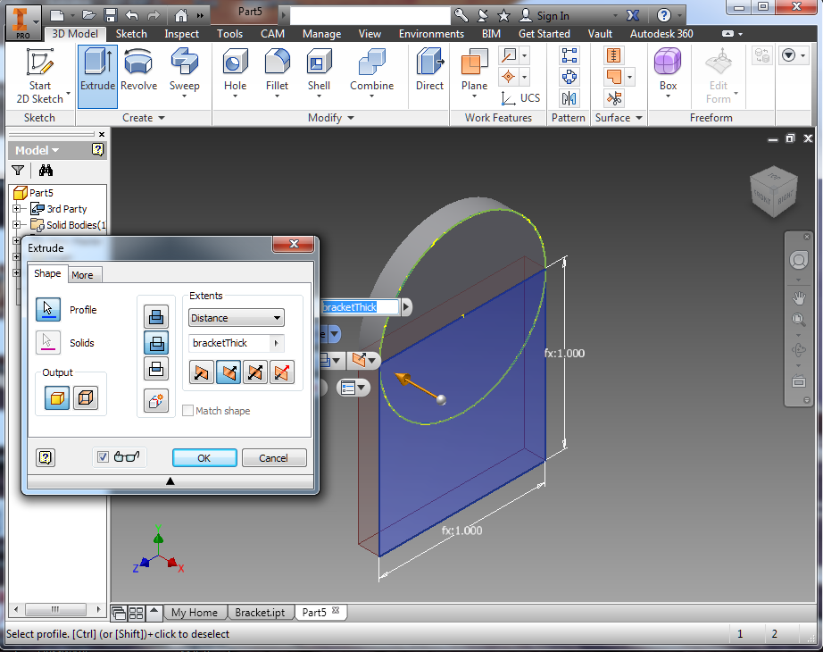
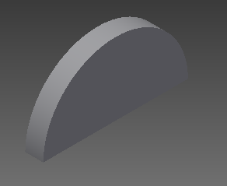
Cut Inward Extrusion
Select Cut and the Inward Direction results in a this shape

Slide 32
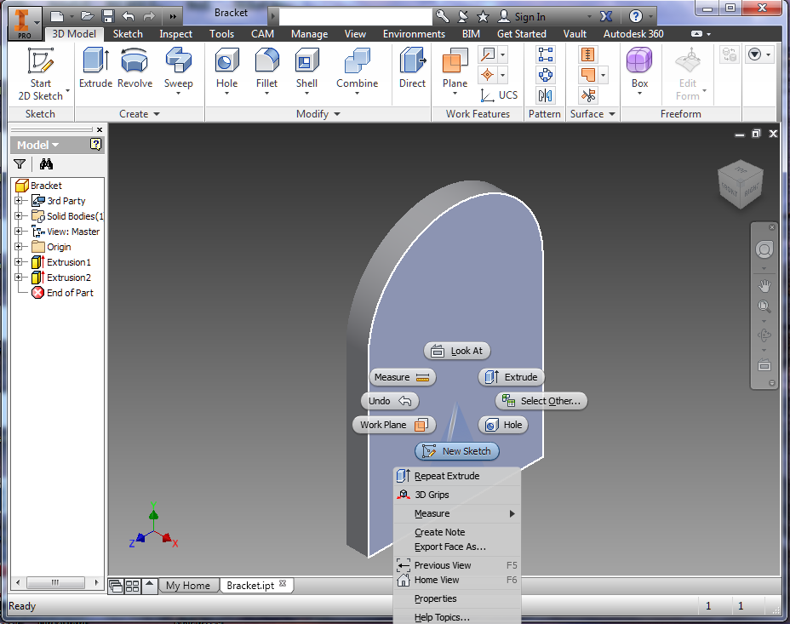
Create Sketch
Right Click on the flat face of the part and select New Sketch

Slide 33
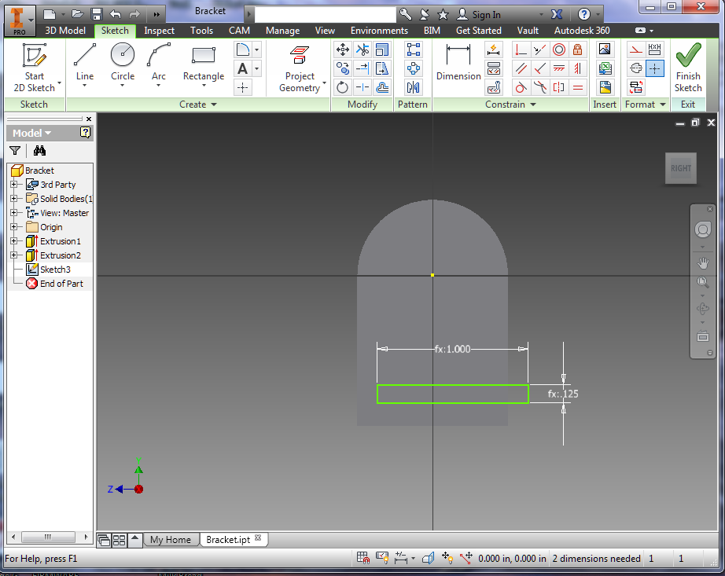
Draw Rectangle
Select the Rectangle Tool and click on the sketch below and to the left of the center of the disc
Drag mouse down and right
Type ‘axleDiameter+2*axleSide’
Press the Tab key
Type ‘bracketThick’
Press Enter key

Slide 34
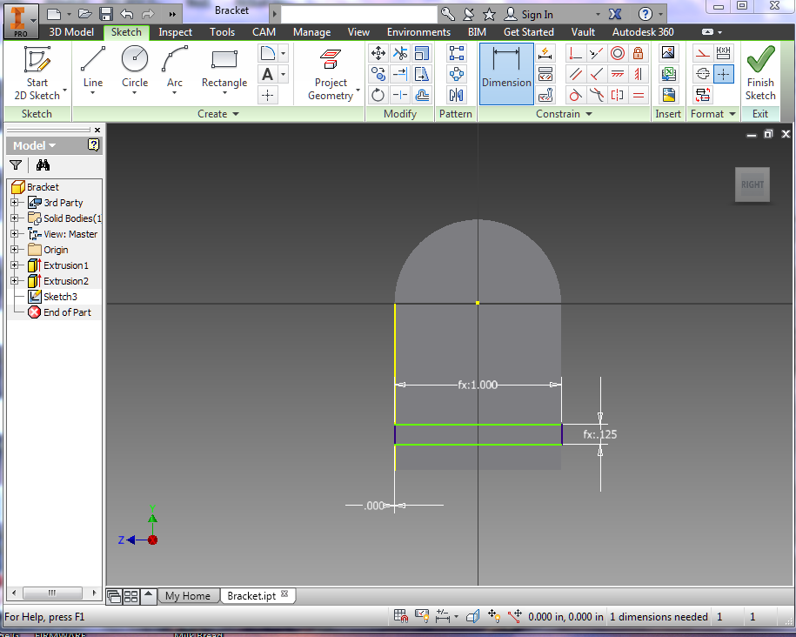
Constrain Horizontal Location
Select Dimension Tool
Click on left side of rectangle
Click on left side of part
Drag mouse down and click
Type ‘0’ into dialog
Press Enter

Slide 35
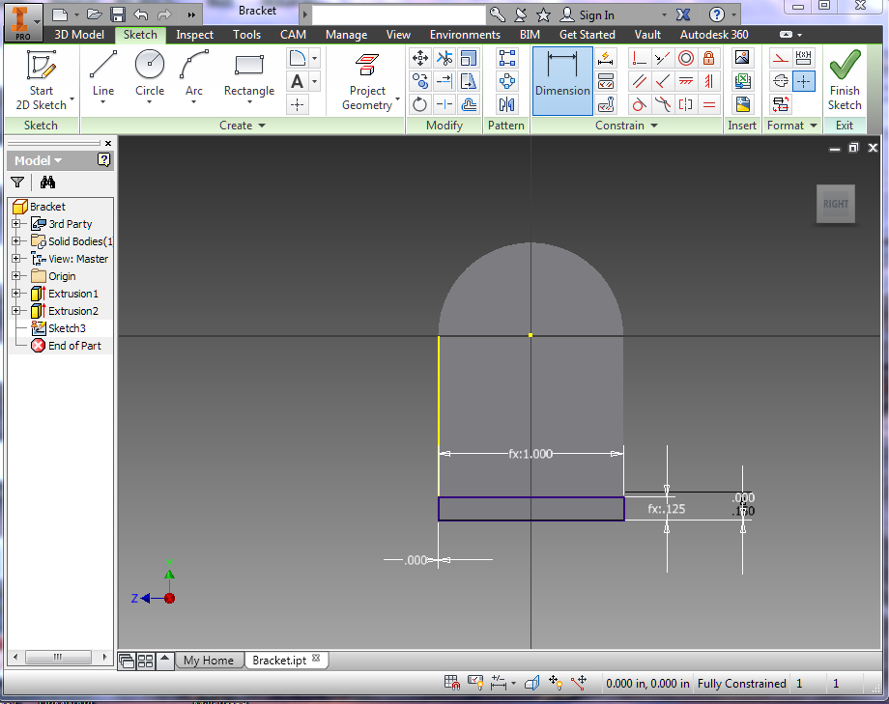
Constrain Vertical Location
Select Dimension Tool
Click on bottom of part
Click on bottom of rectangle
Drag mouse right and click
Type ‘0’ into dialog
Press Enter
Press Finish Sketch

Slide 36
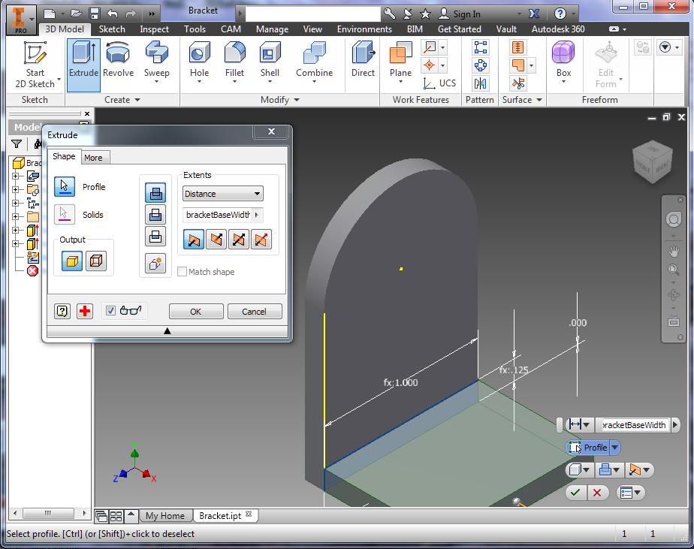
Extrude
Click on the Extrude button
Click on the rectangle in the sketch
In the Extrude dialog type in ‘bracketBaseWidth’ under the Distance dropdown
Match the selections in the picture
Click OK in the dialog

Slide 37
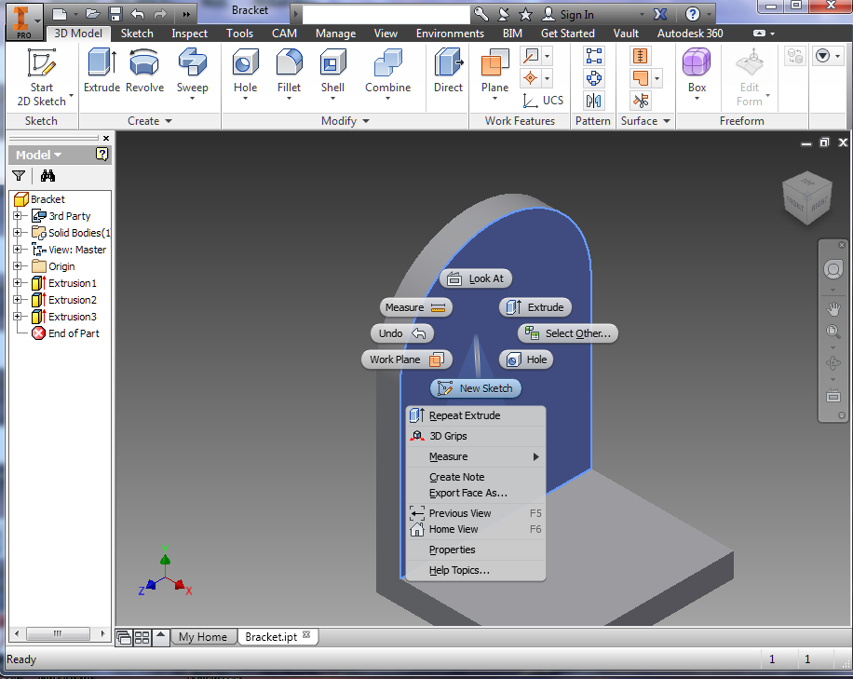
Create Sketch
Right Click on the flat face of the part and select New Sketch

Slide 38
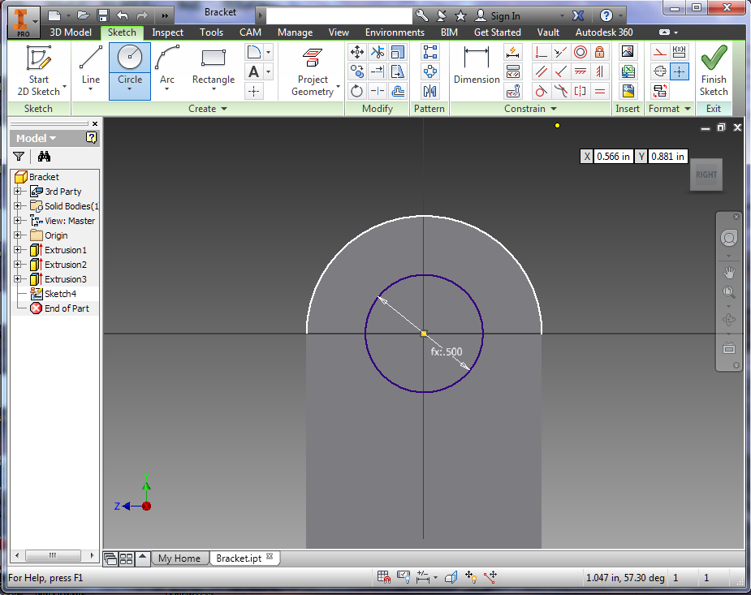
Draw Circle
Click the Circle Button
Click on the yellow origin dot
Drag mouse right
Type ‘axleDiameter’
Press Enter key
Click Finish Sketch

Slide 39
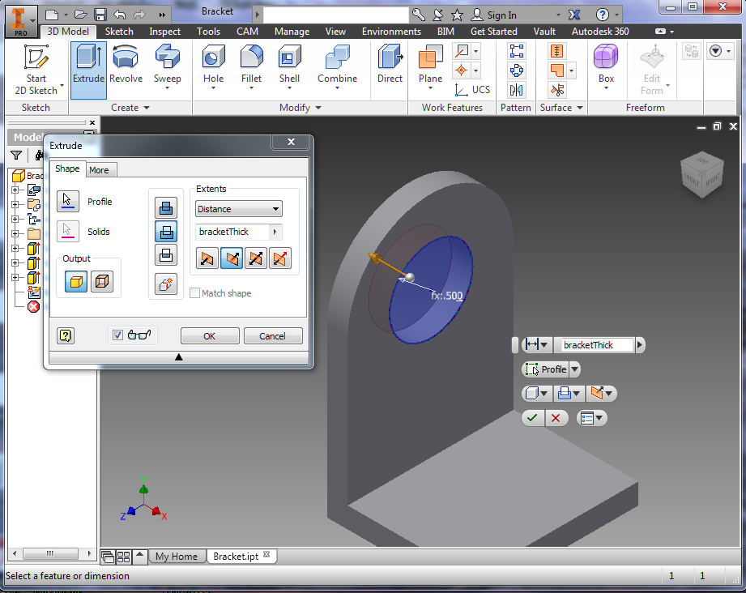
Extrude
Click on the Extrude button
Click on the circle in the sketch
In the Extrude dialog type in ‘bracketThick’ under the Distance dropdown
Match the selections in the picture
Click OK in the dialog

Slide 40
Creating An Assembly
In the I menu (top left) cIick New and select New
In the left window of the dialog click on English
In the middle double click on Standard (in).iam
Click on the I in the top left to Save the assembly as “Robot”

Slide 41
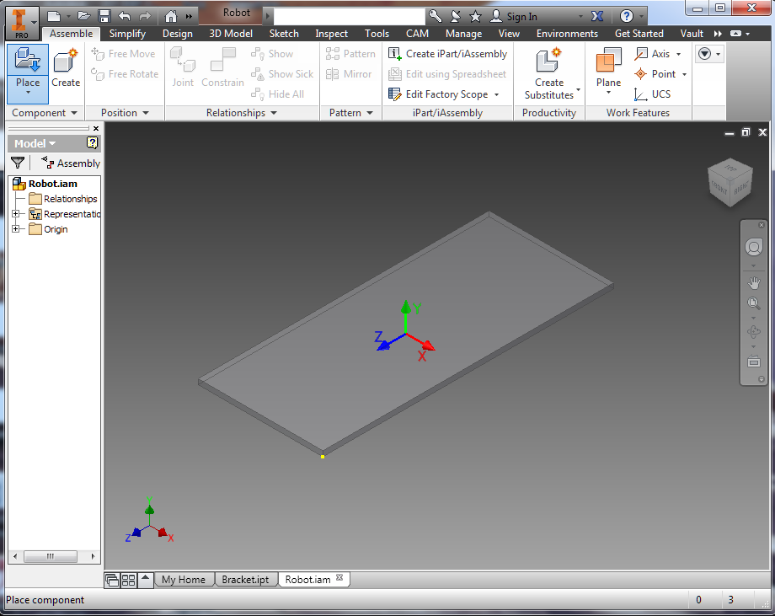
Placing the Body Part
Clicking on the house icon to get the home view
Click on the Place Button
Select the Body.ipt file from the dialog
Click Open
Click on the center of the assembly window

Slide 42
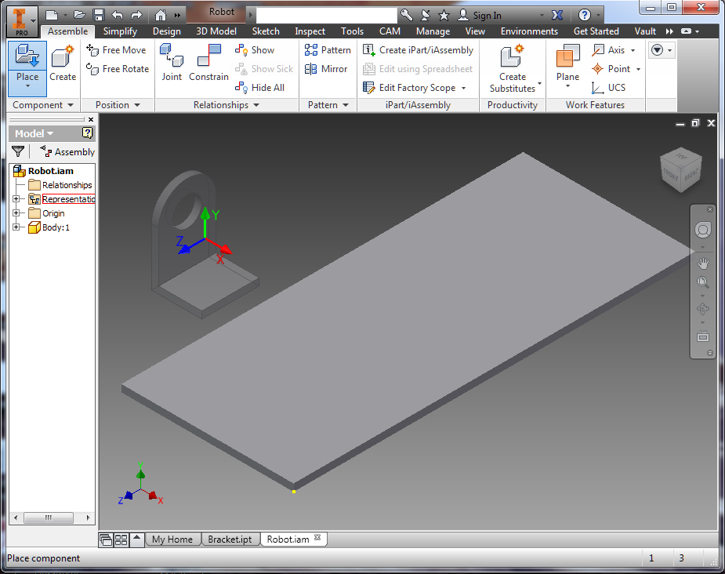
Placing the Bracket
Click on the Place Button
Select the Bracket.ipt file from the dialog
Click Open
Position the bracket as shown in the picture
Click on the assembly window

Slide 43
Moving Around
Zoom - rotate the mouse wheel to zoom in and out based on cursor position in the view window
Rotate - while holding shift key + mouse wheel click, move mouse to rotate part around the origin
Shift - while holding ctrl key + mouse wheel click, move mouse to shift the part in the view

Slide 44
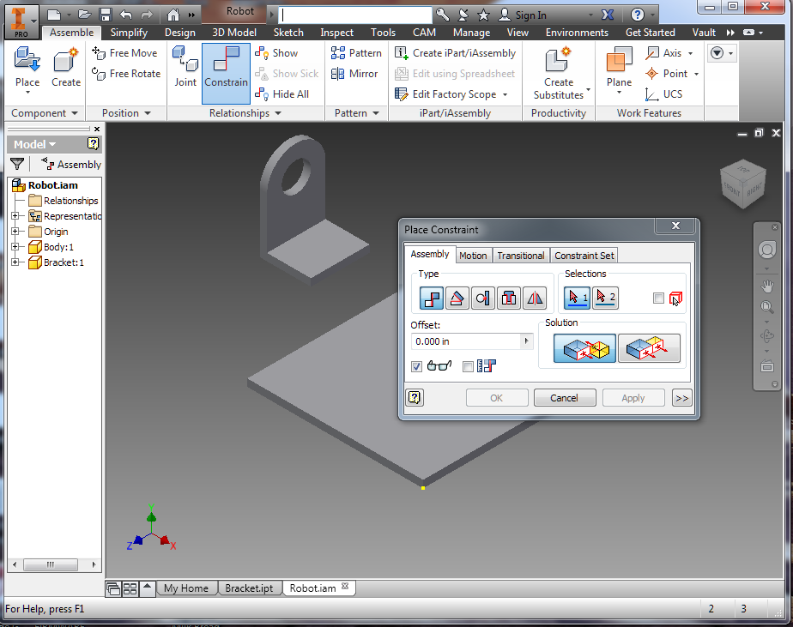
Constraint Types
To join parts into assemblies, use constraints
There are two types of constraints- Mate and Flush
Mate constraints make two selected planes join face to face
Flush constraints make two selected planes join side by side

Slide 45
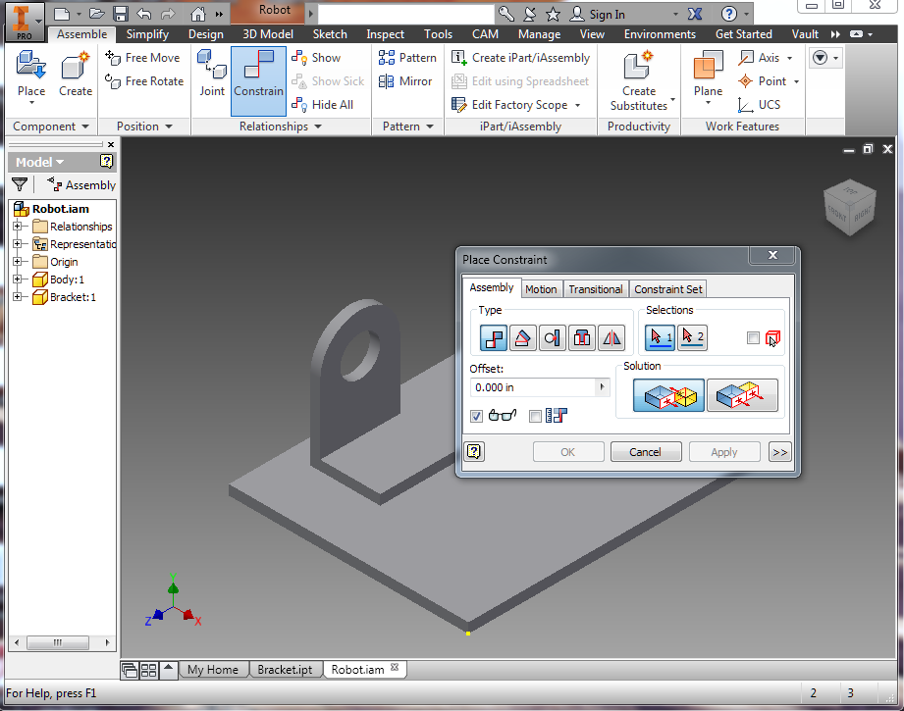
Mate Bottom of Bracket to Top of Body
Click on Constrain
Make sure the Mate option (leftmost) is selected in the Solution section
Click on the top of the Body
Rotate parts and click on the bottom of the bracket
Click Apply

Slide 46
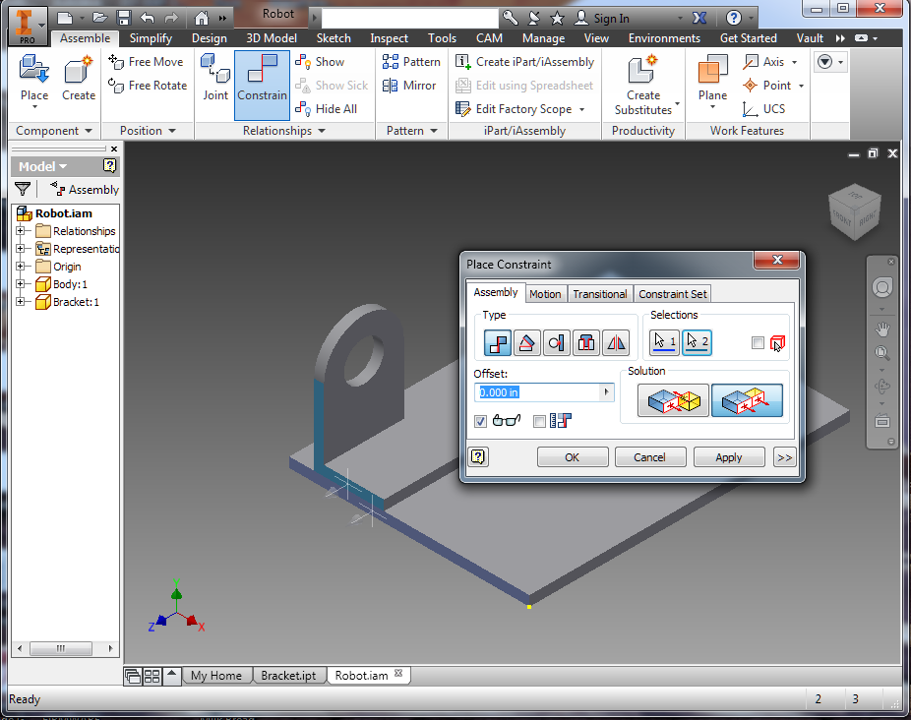
Flush Constrain Bracket Edge To Body Edge
Select the Flush option (rightmost) is selected in the Solution section
Click on the frontmost side (most + plane in Z dir) of the Body
Click on the frontmost side (most + plane in Z dir) of the Bracket
Click Apply

Slide 47
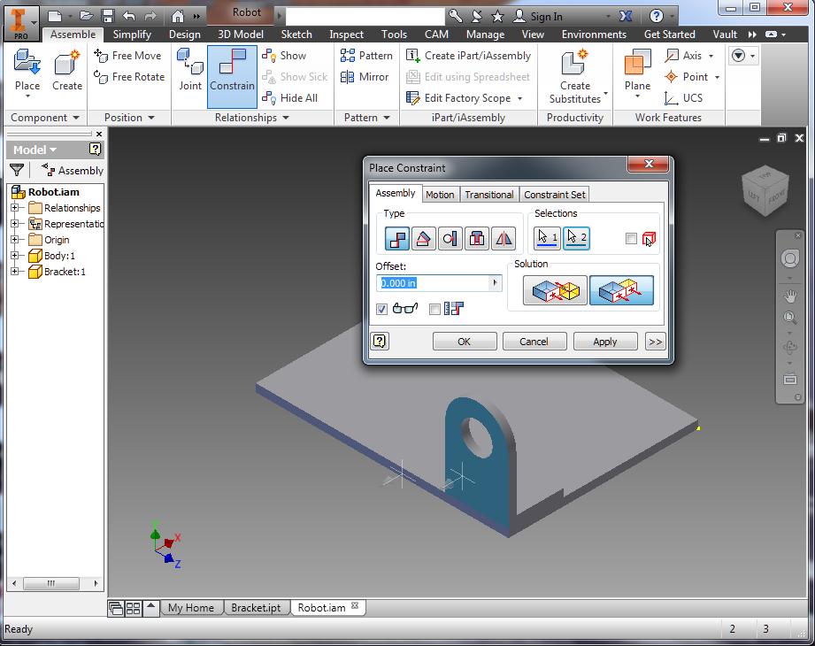
Flush Constrain Bracket Back To Body Left Edge
Rotate parts around to see Bracket Back
Click on the leftmost side (most - plane in X dir) of the Body
Click on the Bracket Back (most - plane in X dir) of the Bracket
Click Apply
Click Cancel

Slide 48
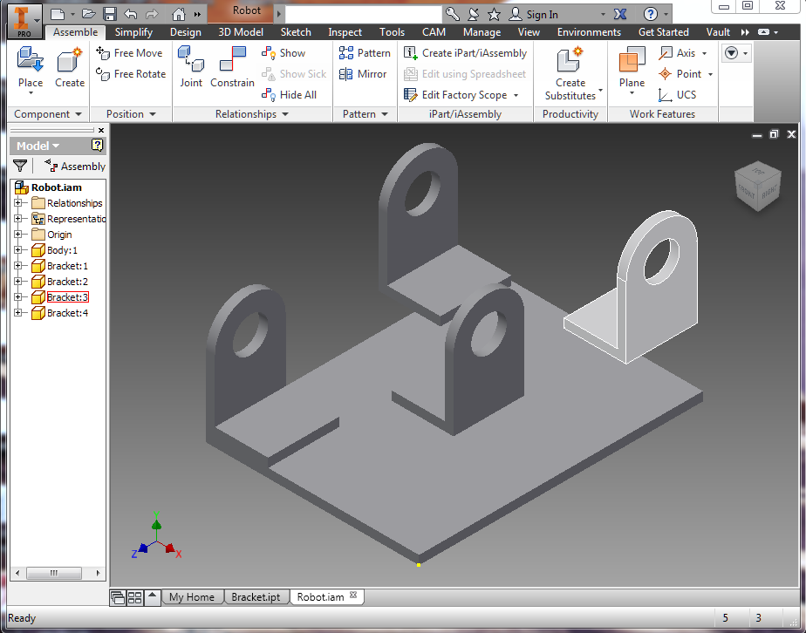
Add Multiple Brackets
Click Place Button
Select Bracket
Click to place Bracket on same side as first bracket
Right click and select Rotate Y 90
Right click and select Rotate Y 90 again
Click to place two more brackets opposite the first bracket

Slide 49
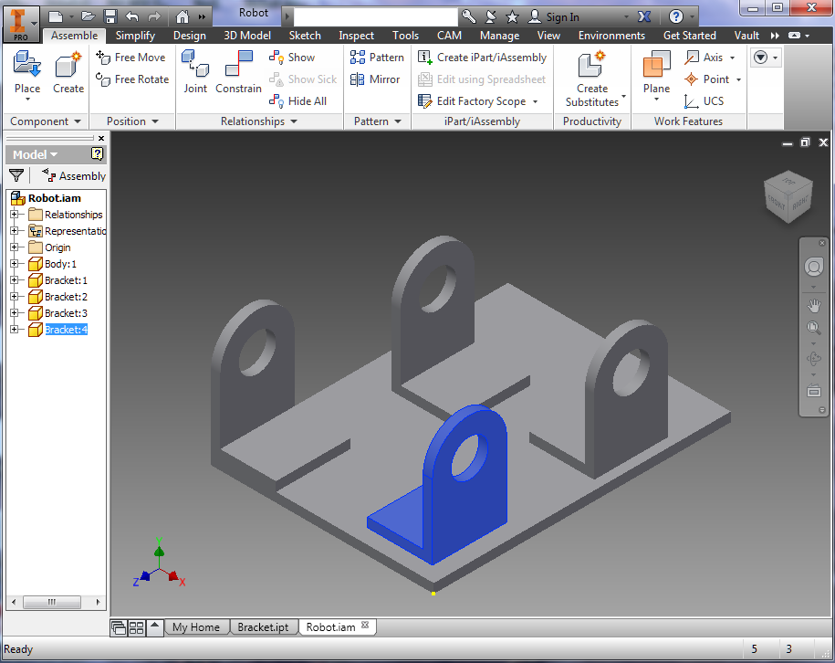
Mate Constrain Bracket Bottoms to Top of Body
Click on Constrain
Make sure the Mate option (leftmost) is selected in the Solution section
Click on the top of the Body
Rotate parts and click on the bottom of a bracket
Click Apply
Repeat Steps for all Brackets

Slide 50
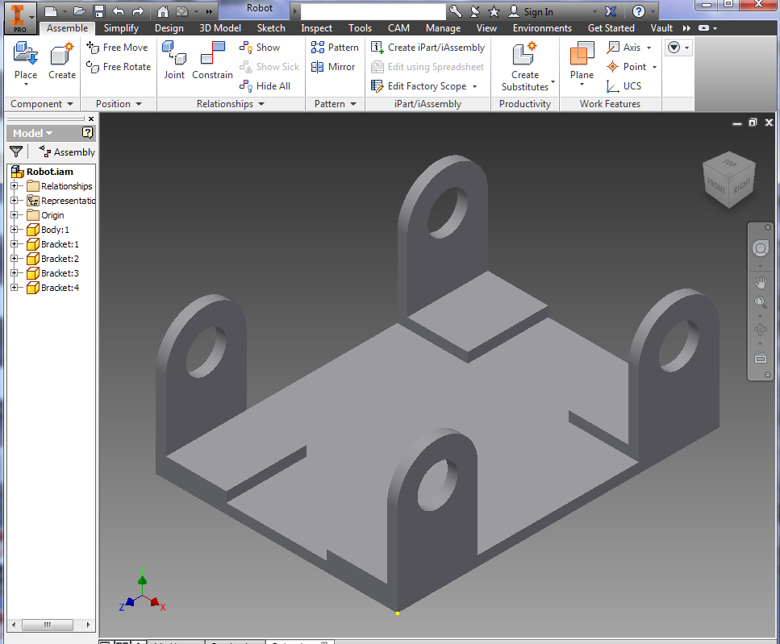
Flush Constrain Bracket To Corners of the Body
Select the Flush option (rightmost) is selected in the Solution section
Click on the planes to constrain the brackets to the corners of the Body

Slide 51

Select All Of The Brackets
Hold down the ctrl key
One by one click on all of the Brackets in the Model window on the left

Slide 52

Change Bracket Color
Click on the Material dropdown on the top bar
Select Light Red

Slide 53

Change Parameters
Change length on spreadsheet to 6 in
Change width to 3 in
Change axleDiameter to .25 in
Save spreadsheet
Click on Update Buttton in top toolbar

